Slide 1
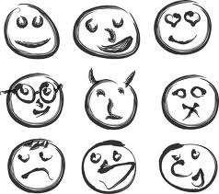
FEELINGS AND EMOTIONS

Slide 2
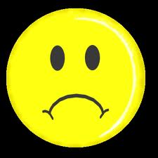
sad

Slide 3
angry

Slide 4
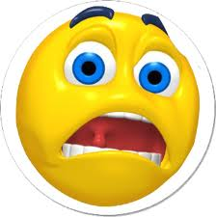
scared or frightened

Slide 5
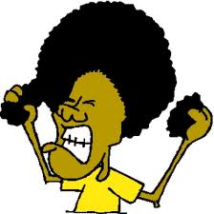
frustrated

Slide 6
shocked or surprised

Slide 7
nervous

Slide 8
embarrassed

Slide 9
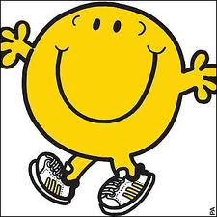
happy

Slide 10
excited or thrilled

Slide 11
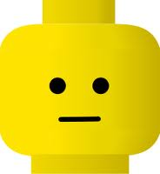
peaceful or calm

Slide 12
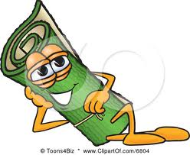
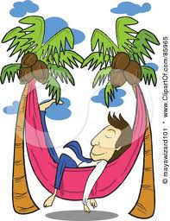
relaxed

